Slide 1
grdb: A Graph Database
Frank W. Miller, Ph.D.
Dept. of Computer Science
University of Colorado

Slide 2
Motivations
Place graph databases on a mathematical foundation similar to the relational model
Scale
Our approach: Divide-and-Conquer

Slide 3
Graph Database Model
S_{V}
S_{E}
Normal Form graphs: single vertex schema and single edge schema
S_{V}
S_{E}
These look a lot like relations!
General graph: arbitrary schemas on vertices and edges
S_{V}
S_{E}

Slide 4
Graph Database Definition
Database is a set of graphs
Each graph is a set of connected components that have common vertex and common edge schemas
G = { C₁, C₂, … , C_{n}}
C_{i} = { V, S_{V}, E, S_{E} }
S_{V} is the vertex schema
S_{E} is the edge schema
Schemas are sets of base types
int, float, double, bool, etc.
Enumerated types

Slide 5
Conversion to Normal Form
Algorithm similar to Kruskal
Create a set of Constant Schema Trees (CSTs)
G = {}
while (V != {}) do
Select u ∈ V
Select v ∈ neighbors(u) with the largest schema common to u and v
if no such vertex v exists then
Complete-Edges(G)
Complete-Vertices(G)
break
endif
new g = ({u,v},{(u,v)}
CST-Grow(g, G)
Project g out of G
Insert g in G
endwhile

Slide 6
CST-Grow
CST-Grow(g, G)
N = neighbors(g)
Search the edge set between g and N for an edge (u, v) with u ∈ V and v ∈ N that have the largest schemas in common with g
If no such edge exists then return
Remove v from G and insert (u, v) into g
CST-Grow(g, G)
end

Slide 7
Convert to Normal Form Completion
CST-Complete-Edges(G)
If no edges remain in G return
Remove an edge e = (u,v) from G
new g = ({u,v},{(u,v)})
Insert g in G
CST-Complete-Edges(G)
end
CST-Complete-Vertices(G)
if no vertices remain in G return
Remove a vertex v from G
new g = ({u},{})
Insert g in G
CST-Complete-Vertices(G)
end

Slide 8
An Algebra for Graph Algorithm Implementation
A set of familiar operations is available for use with the CSTs
Assume that components in the same graph share a vertex id space

Slide 9
Graph Database Algebra
Projection
G’ = π_{A,B}(G)
V’ = V
E’ = E
S_{V}’ = A ⊆ S_{v} and S_{E}’ = B ⊆ S_{E}

Slide 10
Graph Database Algebra
Selection:
G’ = σ_{C}(G)
V’ ⊆ V
E’ ⊆ E such that ∀e ∈ E’, such that if e= (v_{i}, v_{j}), then both v_{i}, v_{j} ∈ V’
S_{v}’ = S_{v} and S_{E}’ = S_{E}
all the vertices and edges in V’ and E’, respectively, meet the condition specified by C

Slide 11
Graph Database Algebra
Vertex Join
G’ = G₁ ⨝ G₂
V’ = V₁ ⋃ V₂
E’ = E₁ ⋃ E₂
Sv’ = S_{V1} ⋃ S_{V2}
S_{E}’ = S_{E1} ⋃ S_{E2}

Slide 12
Implementation
Command line interface
Graph Database
(C) Frank W. Miller
grdb> g n
grdb> g e 1 2
grdb> g e 2 3
grdb> g e 3 1
grdb> g
>0:({1,2,3},{(1,2),(2,3),(3,1)})
grdb> g s v int i
grdb> g s v double f
grdb> g s e bool x
grdb> g s
>graph 0
Sv = [INT:i,DOUBLE:f]
Se = [BOOL:x]
grdb> g t
({1[0,0.00],2[0,0.00],3[0,0.00]},{(1,2)[FALSE],(2,3)[FALSE],(3,1)[FALSE]})
grdb>

Slide 13
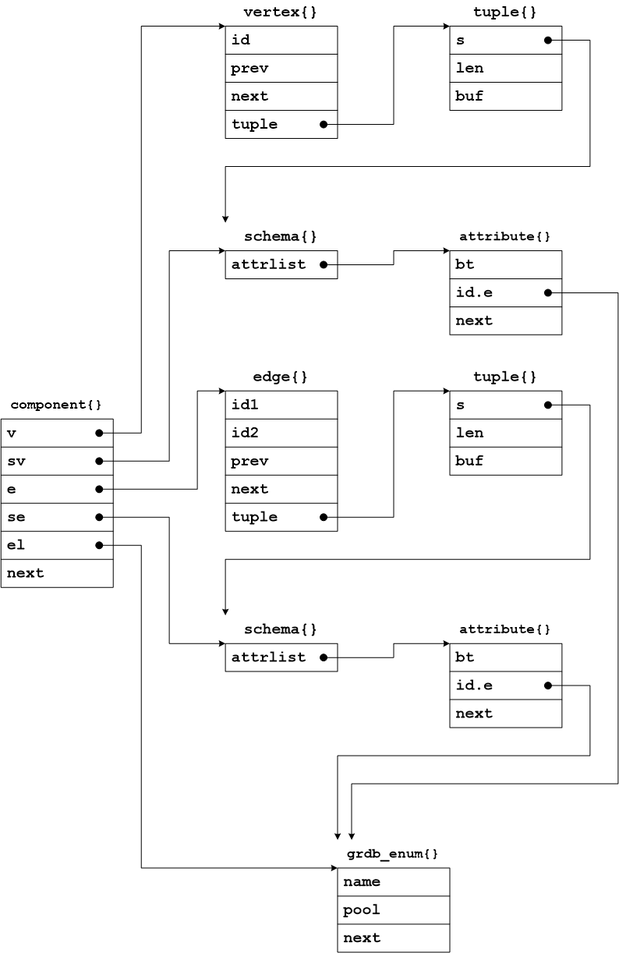
In Memory Data Structures

Slide 14
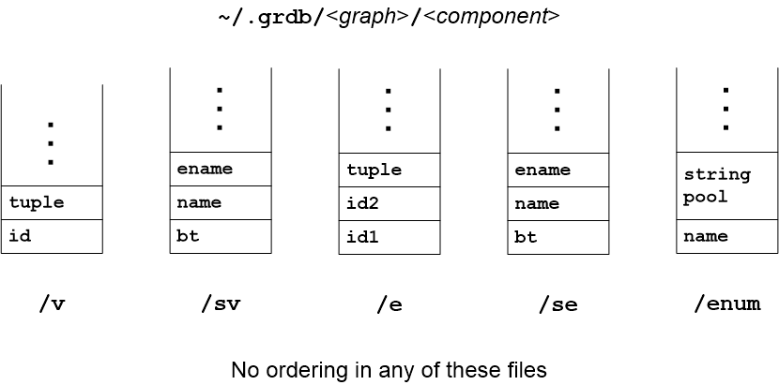
Persistent Data Structures

Slide 15
Implementation
GPLv3
Written in C
https://github.com/fwmiller/grdb

Slide 16
Early Result
Since the graph is stored as a set of connected components, testing for connectivity can be done with an O(n) set intersection
Normally would use an O(nlogn) alg., e.g. Dijkstra
Work done to convert to normal form results in amortized savings over many tests
Beckman, I. and Miller, F. W.

Slide 17
Status
New work in progress, i.e. no query language
Storage backend recently completed
Open source code base available
Publications in progress

